Slide 1


Onboarding walkthrough

Slide 2











G Suite
mail.google.com
Head here to begin setting up your email account!

Slide 3
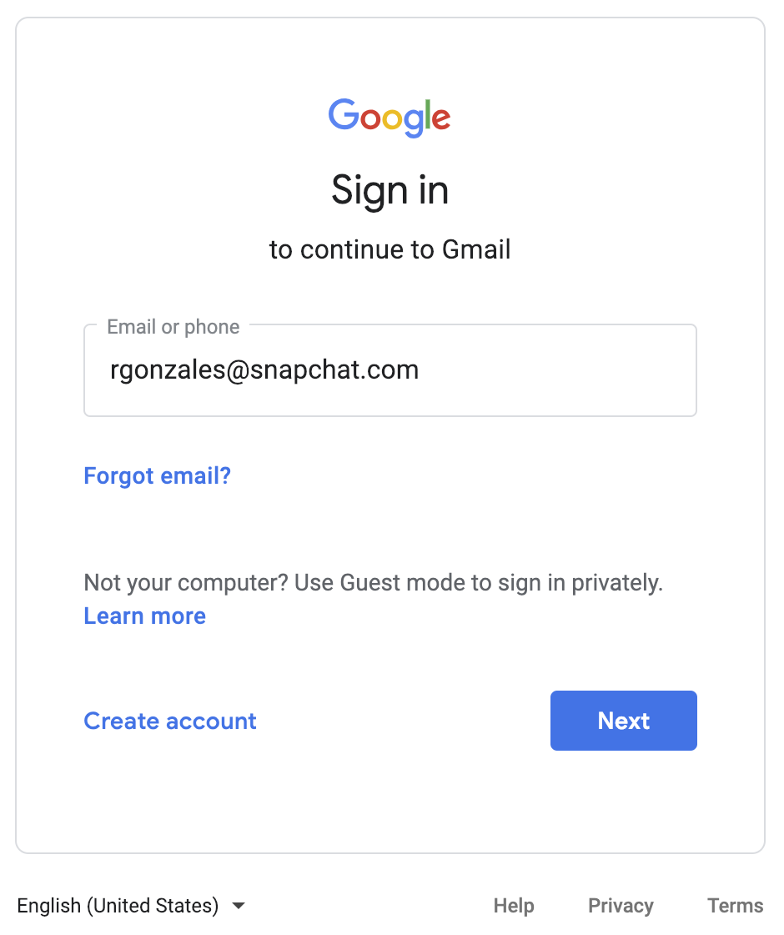
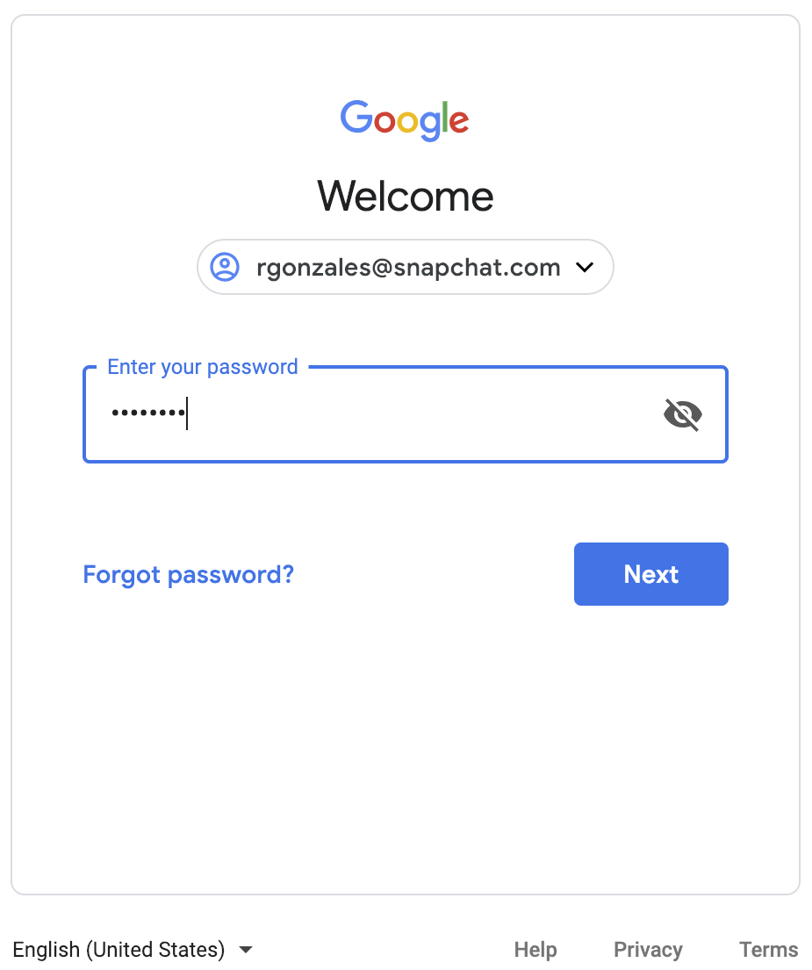
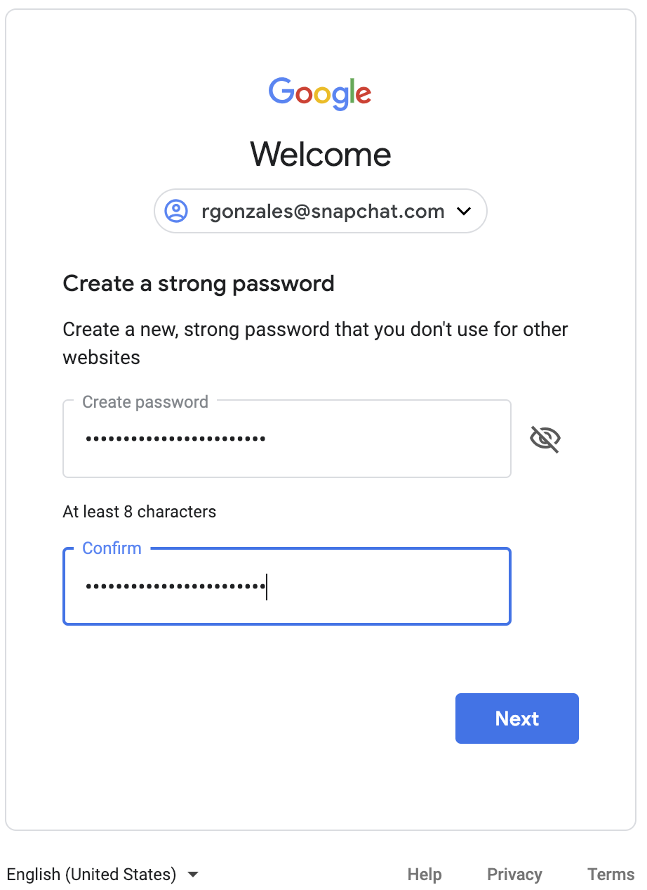
Change Your Google Password
Use your temporary credentials to sign in. You will then be prompted to create a new password.
st4yin5ide

Slide 4
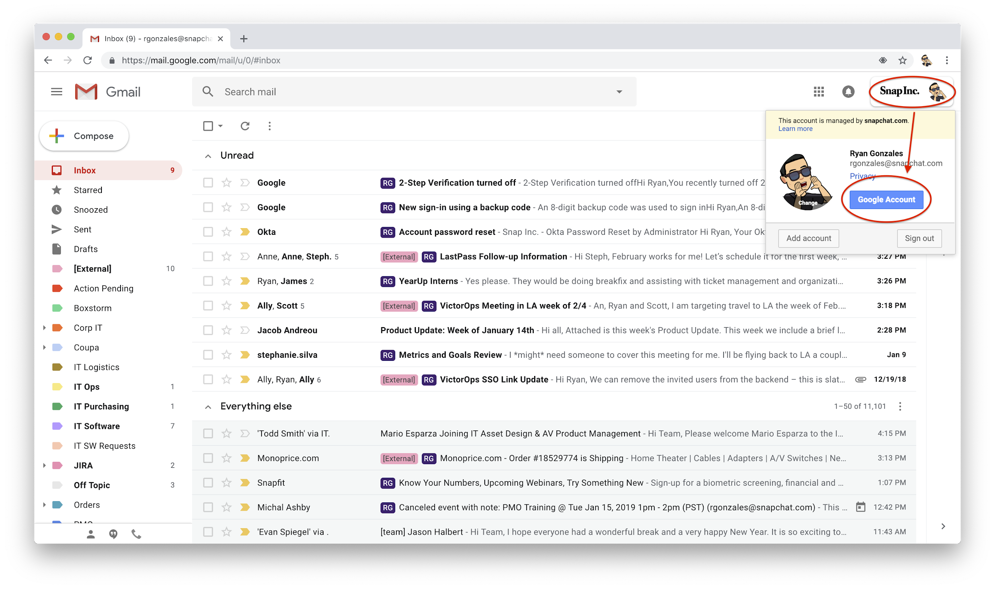
Google 2-Step: SMS
Now that you’re signed in, follow the path below to set up 2-step verification, starting with text message verification.

Slide 5
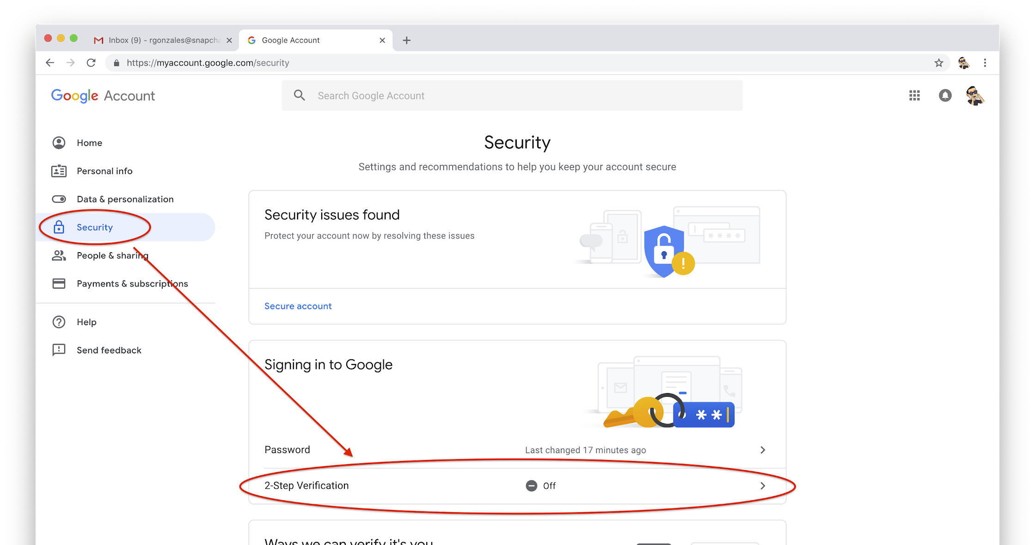
Google 2-Step: SMS

Slide 6
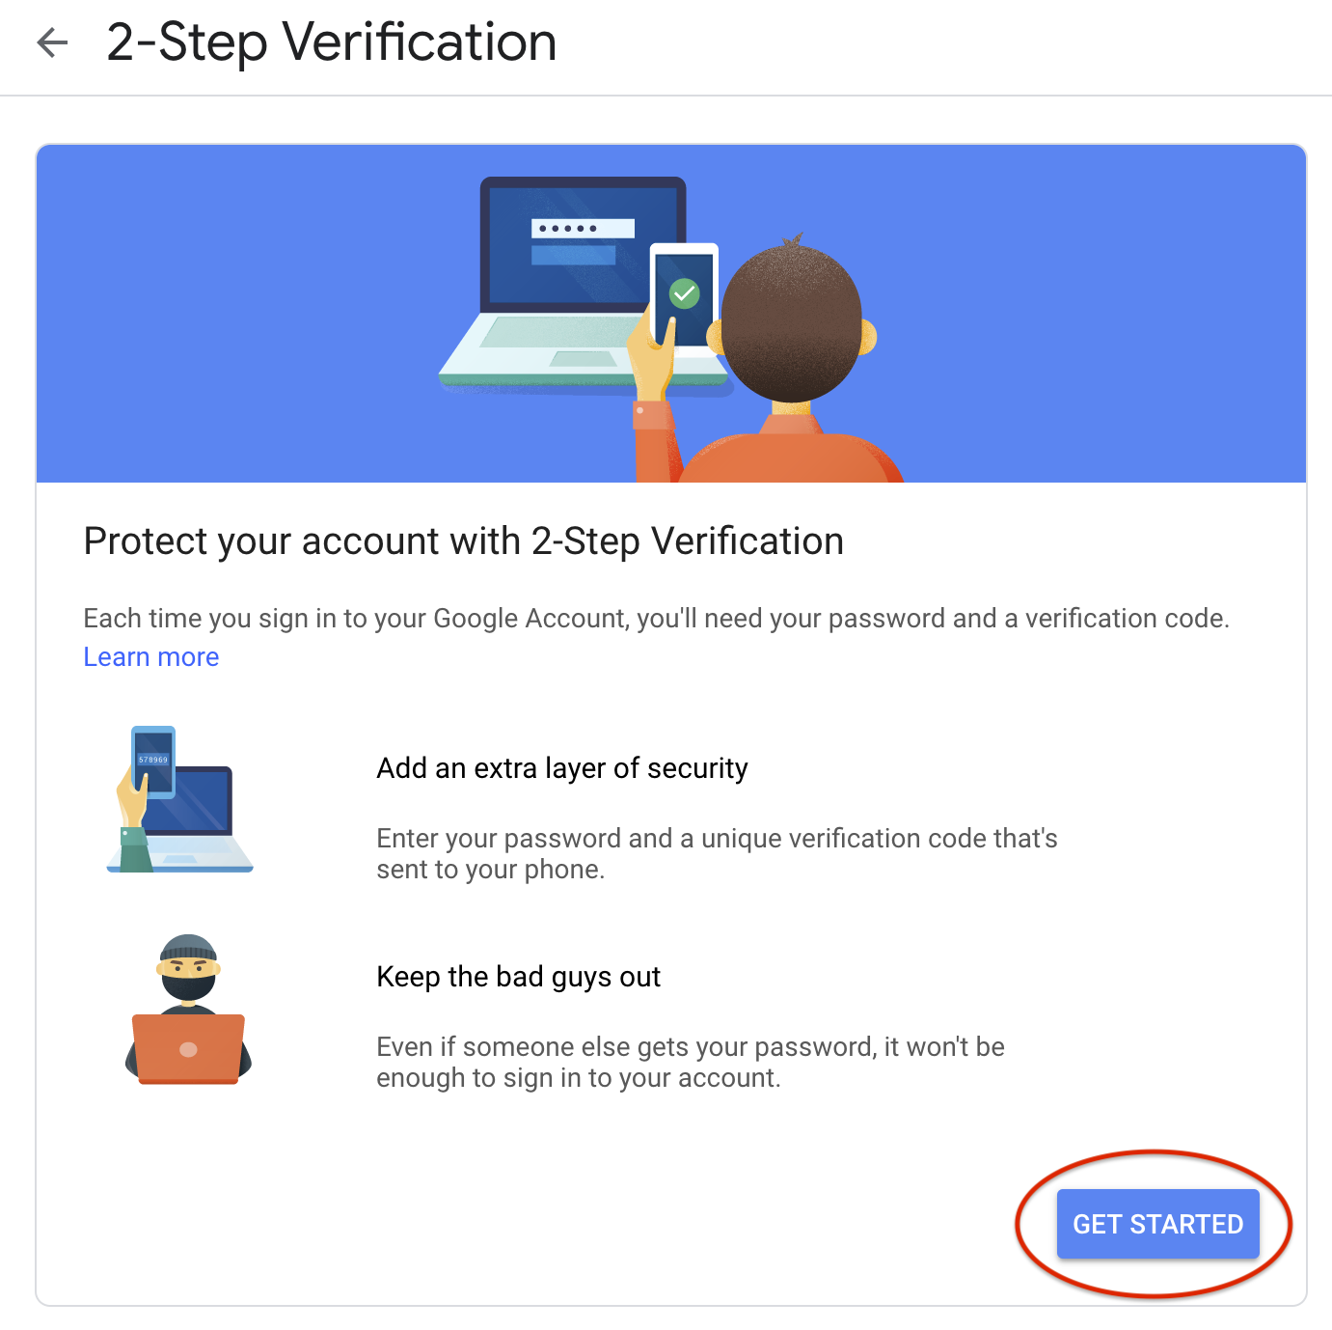
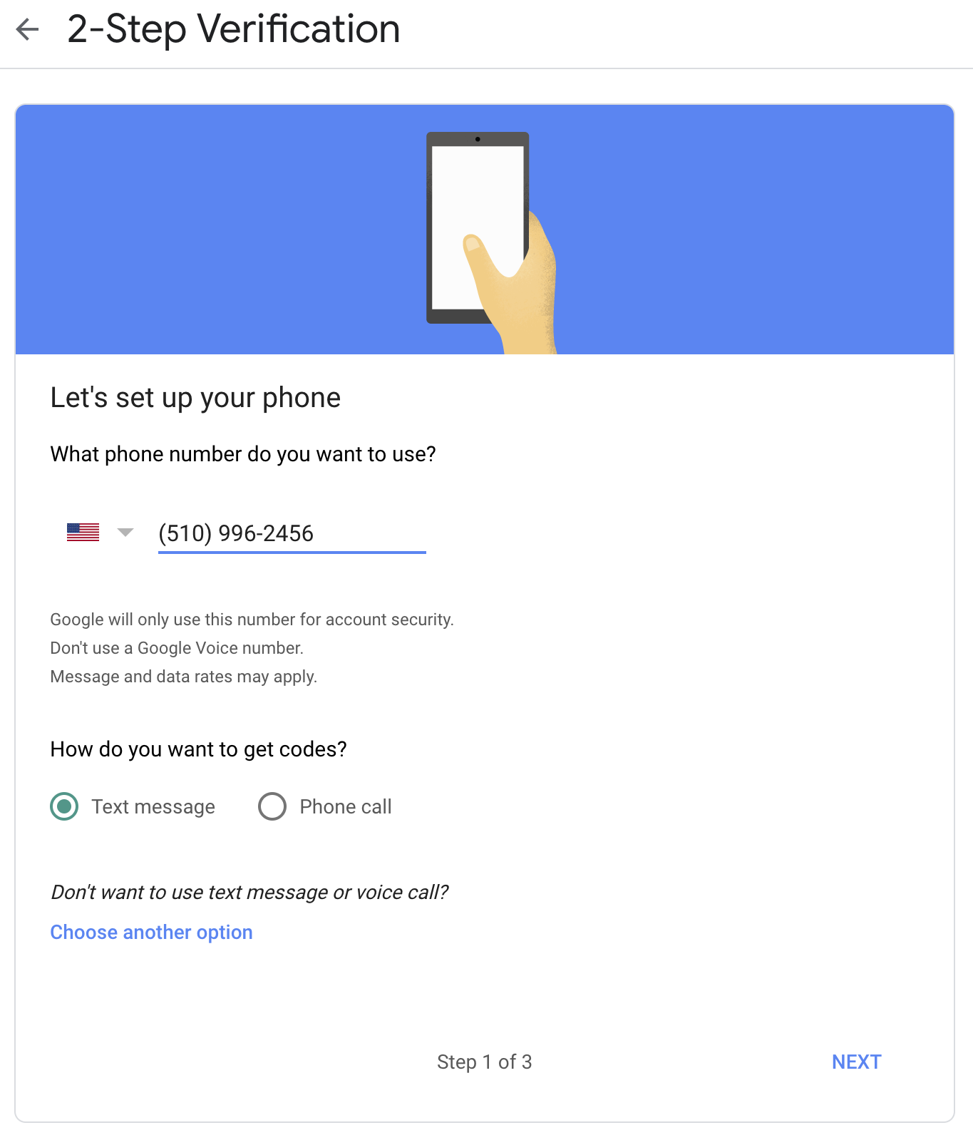
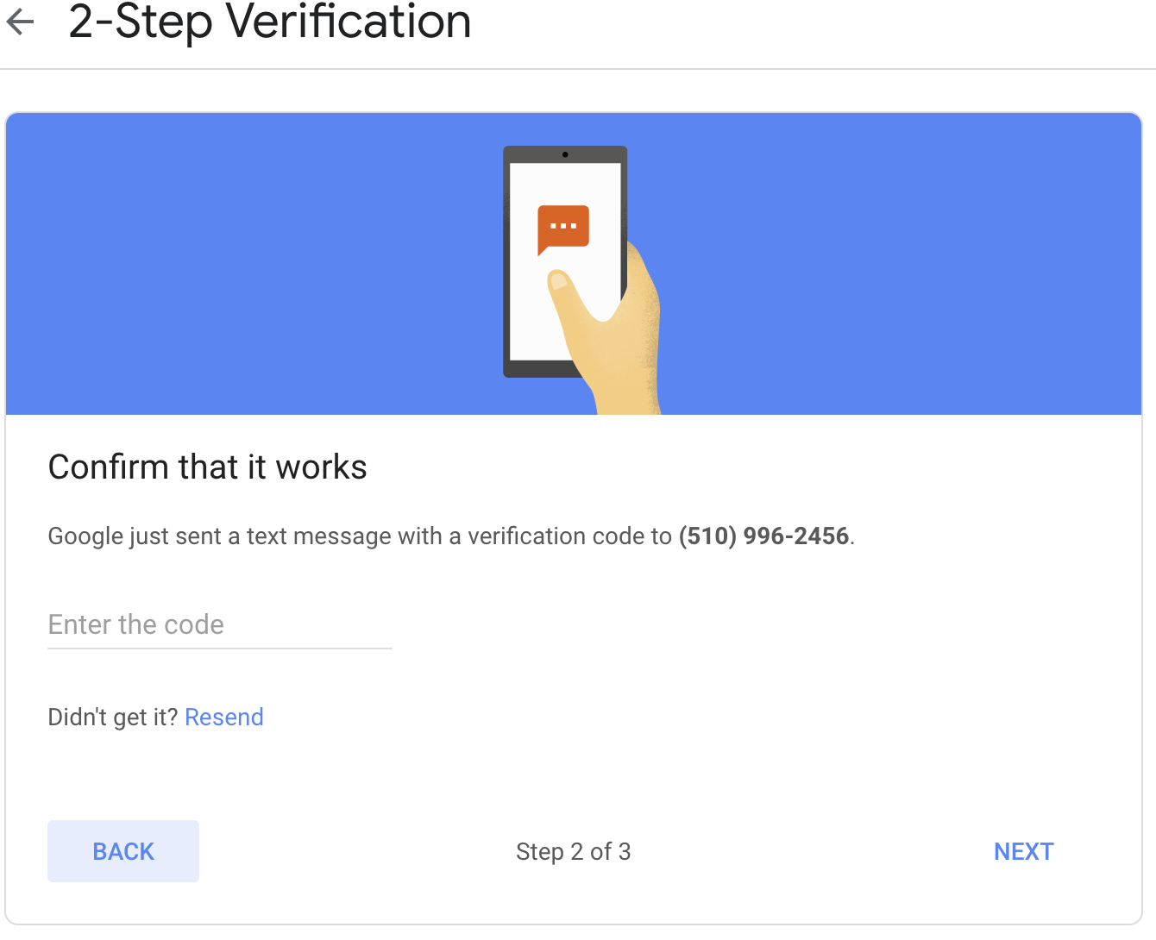
Google 2-Step: SMS

Slide 7
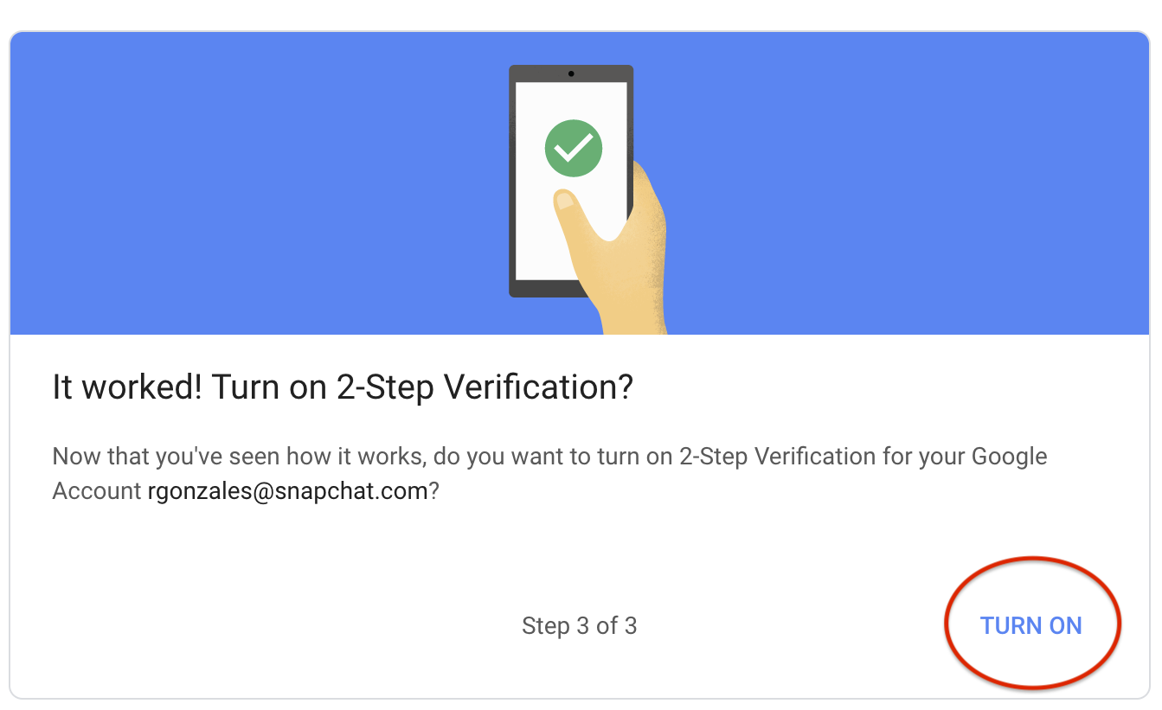
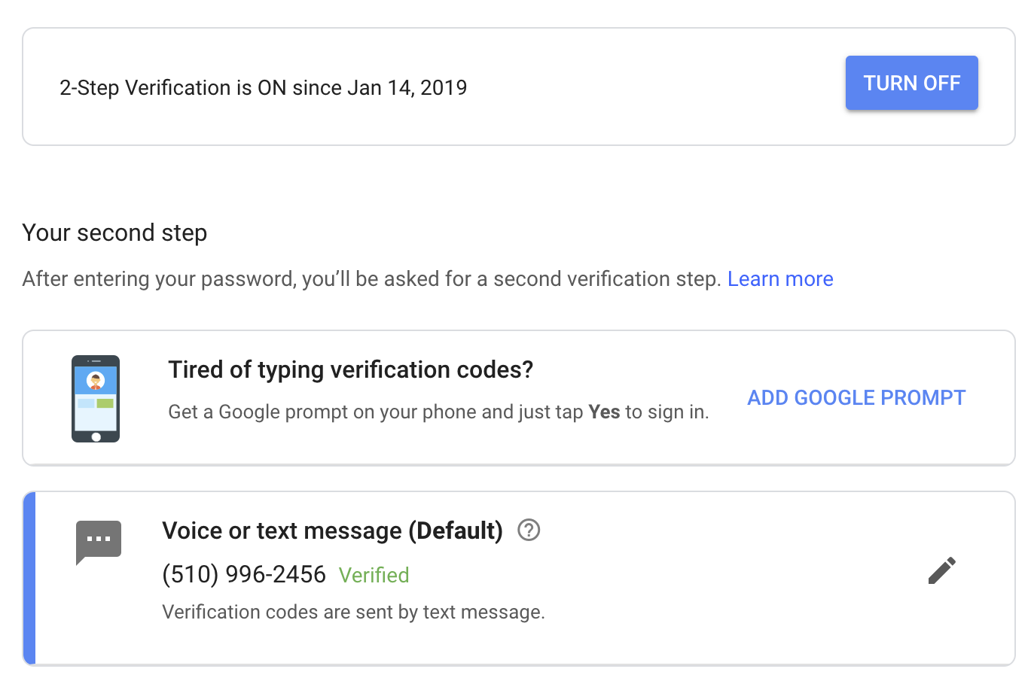
Google 2-Step: SMS

Slide 8
Google 2-Step: Authenticator
We also need to set up Google Authenticator as a second form of authentication. Make sure to have your phone handy!

Slide 9
Google 2-Step: Authenticator

Slide 10
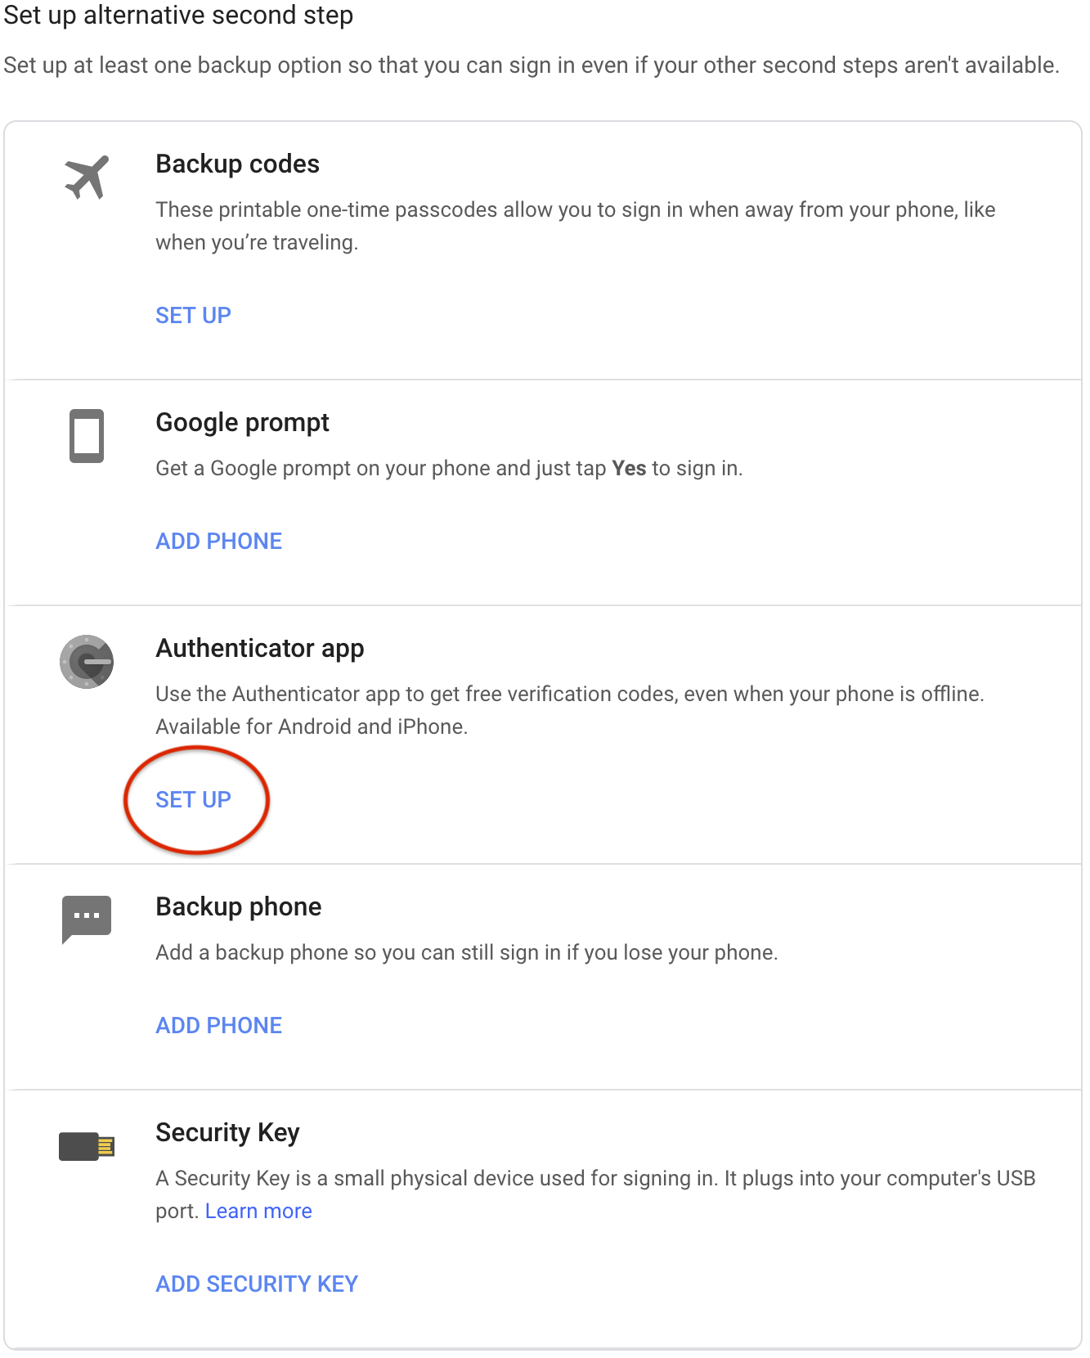
Google 2-Step: Authenticator

Slide 11
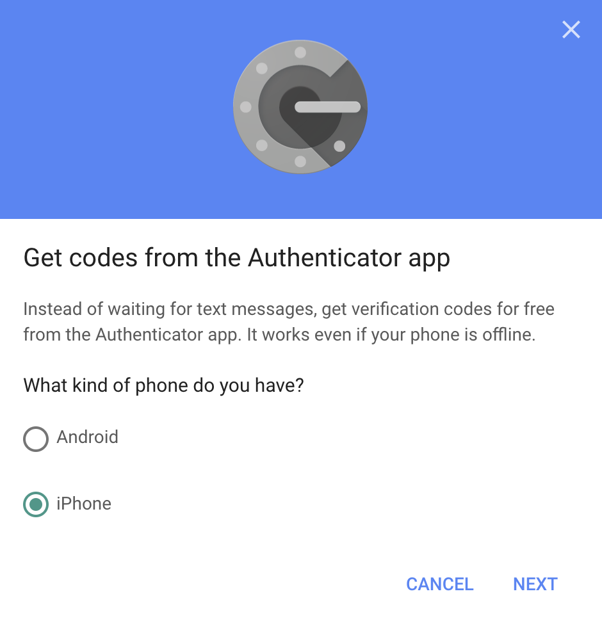
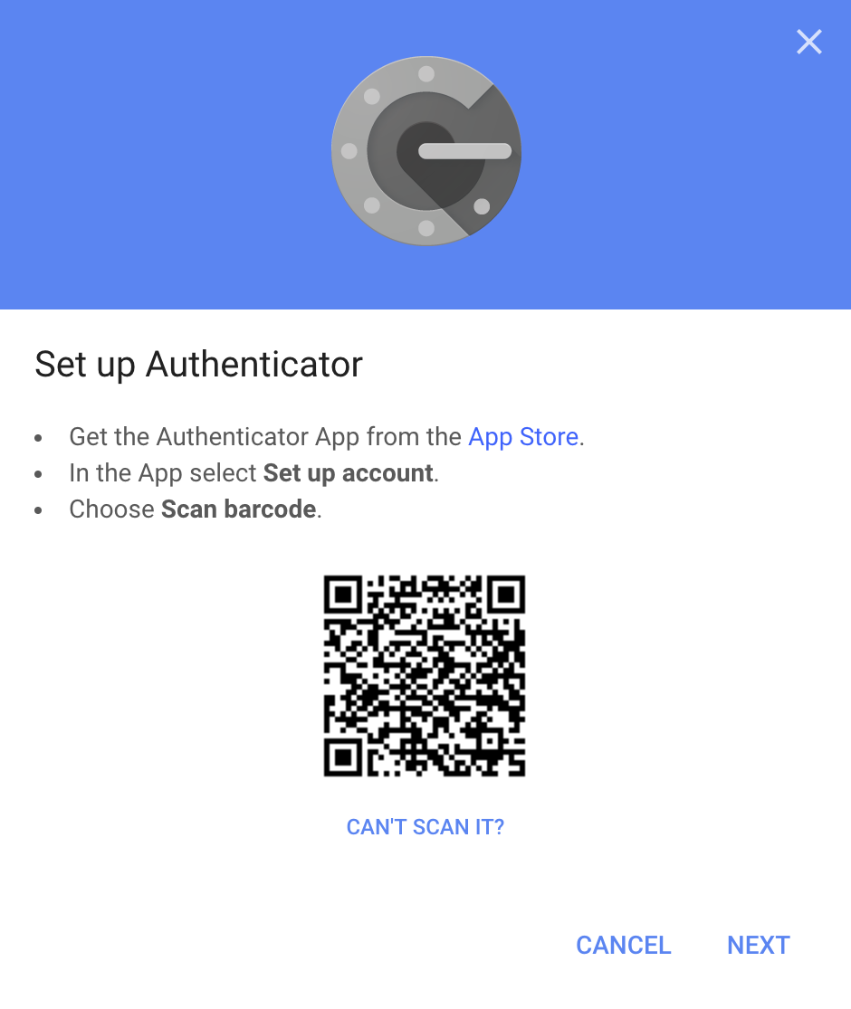
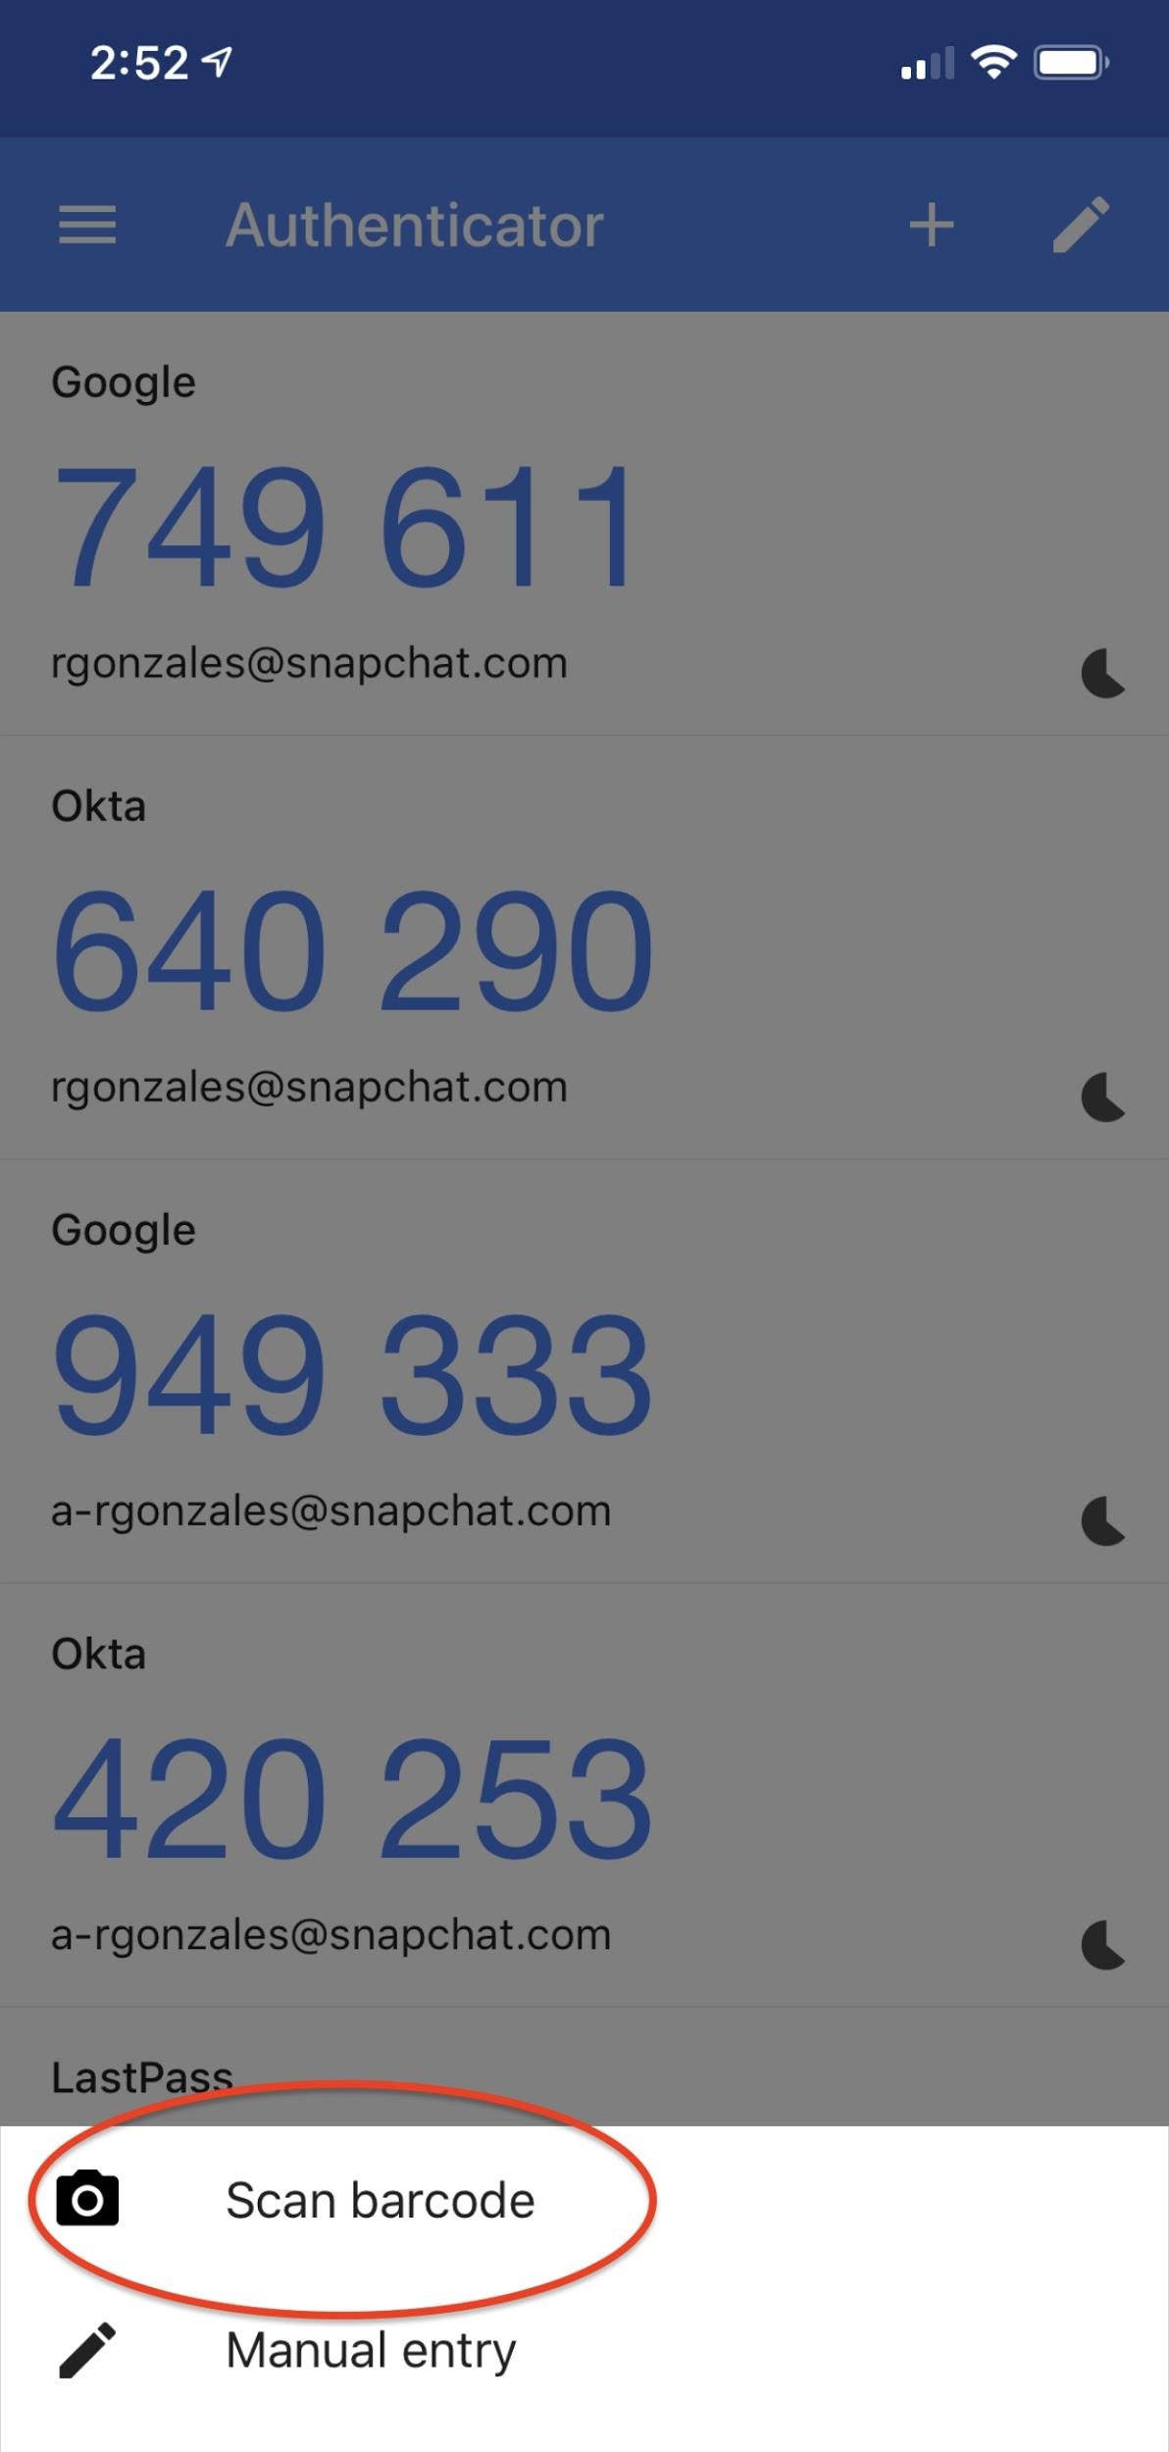
Google 2-Step: Authenticator
Download the Google Authenticator app on your phone, follow the steps below and scan the barcode with your phone when prompted.

Slide 12
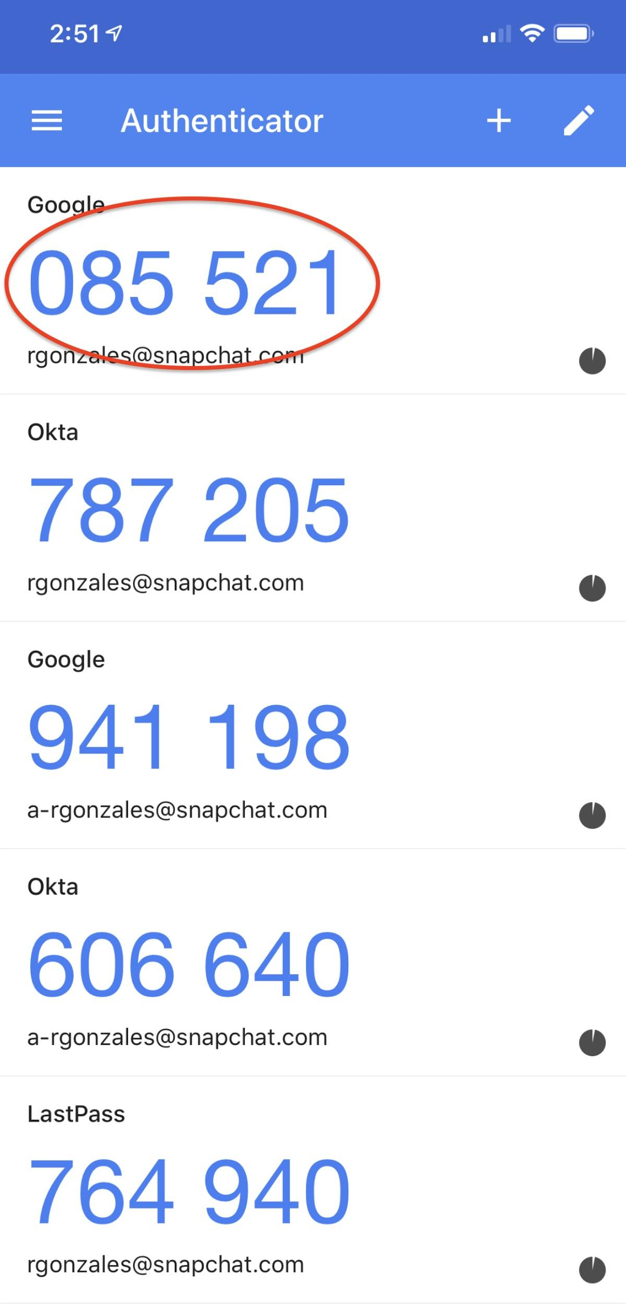
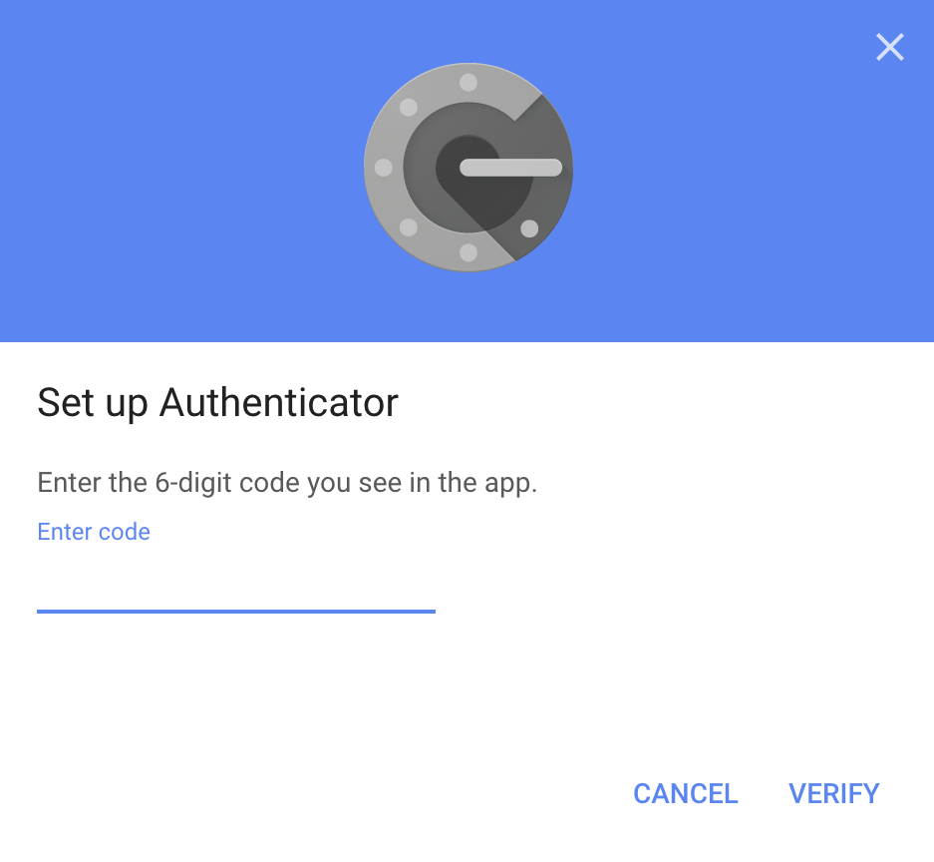
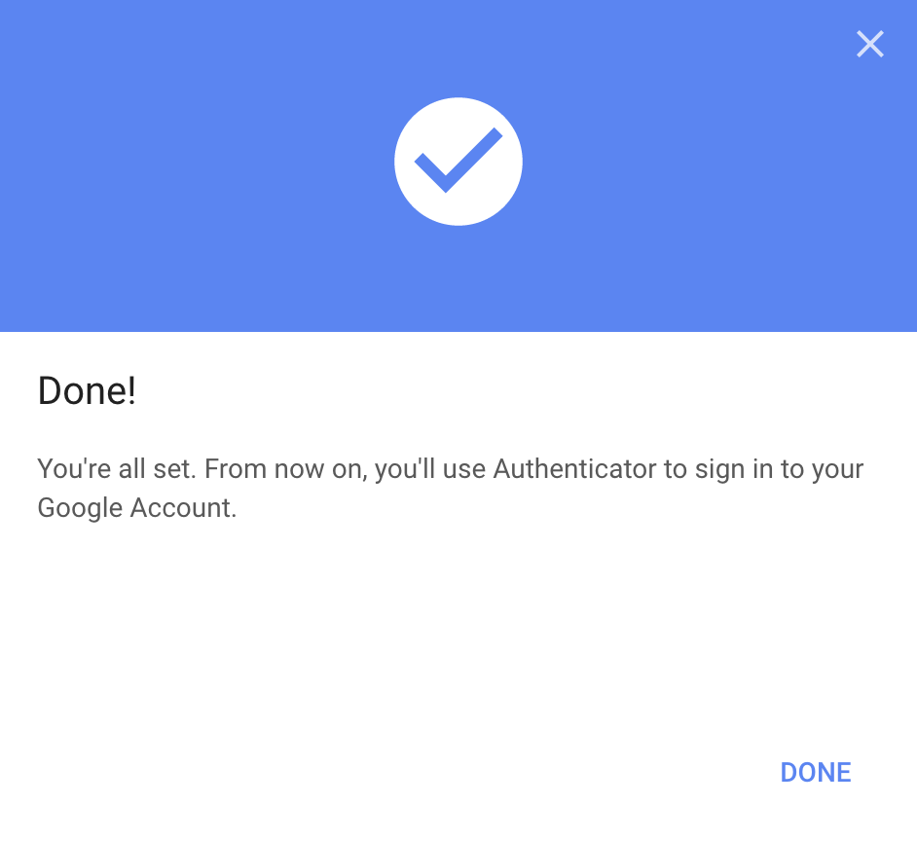
Google 2-Step: Authenticator
Make sure to enter the code from your phone, hit verify, and select done when finished!

Slide 13
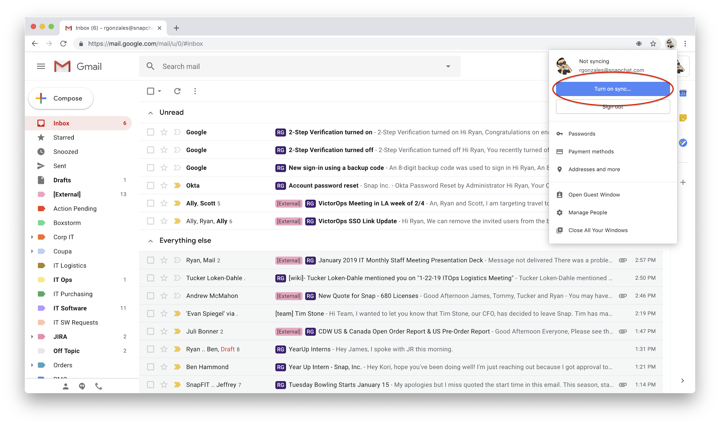
Google Chrome Profile
To automatically get Snap related bookmarks in Chrome, sync your account!

Slide 14
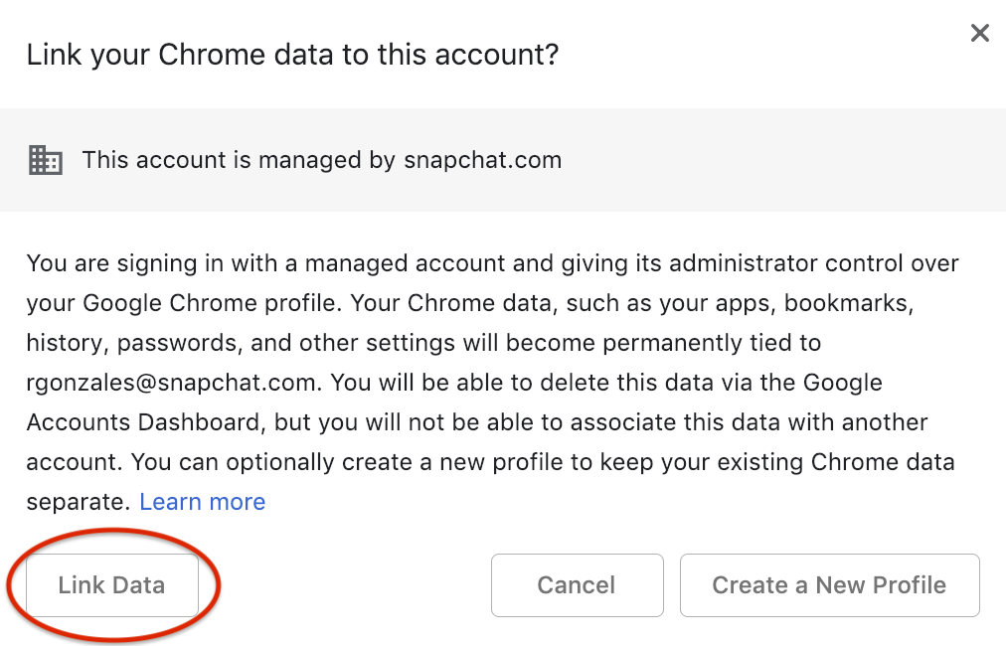
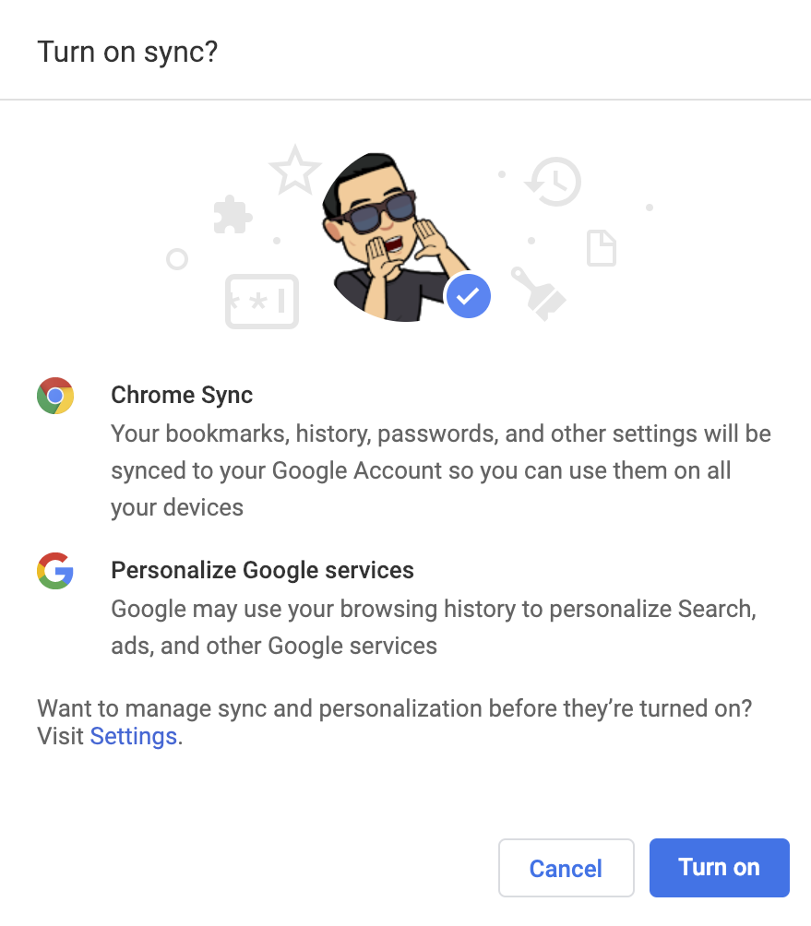
Google Chrome Profile

Slide 15
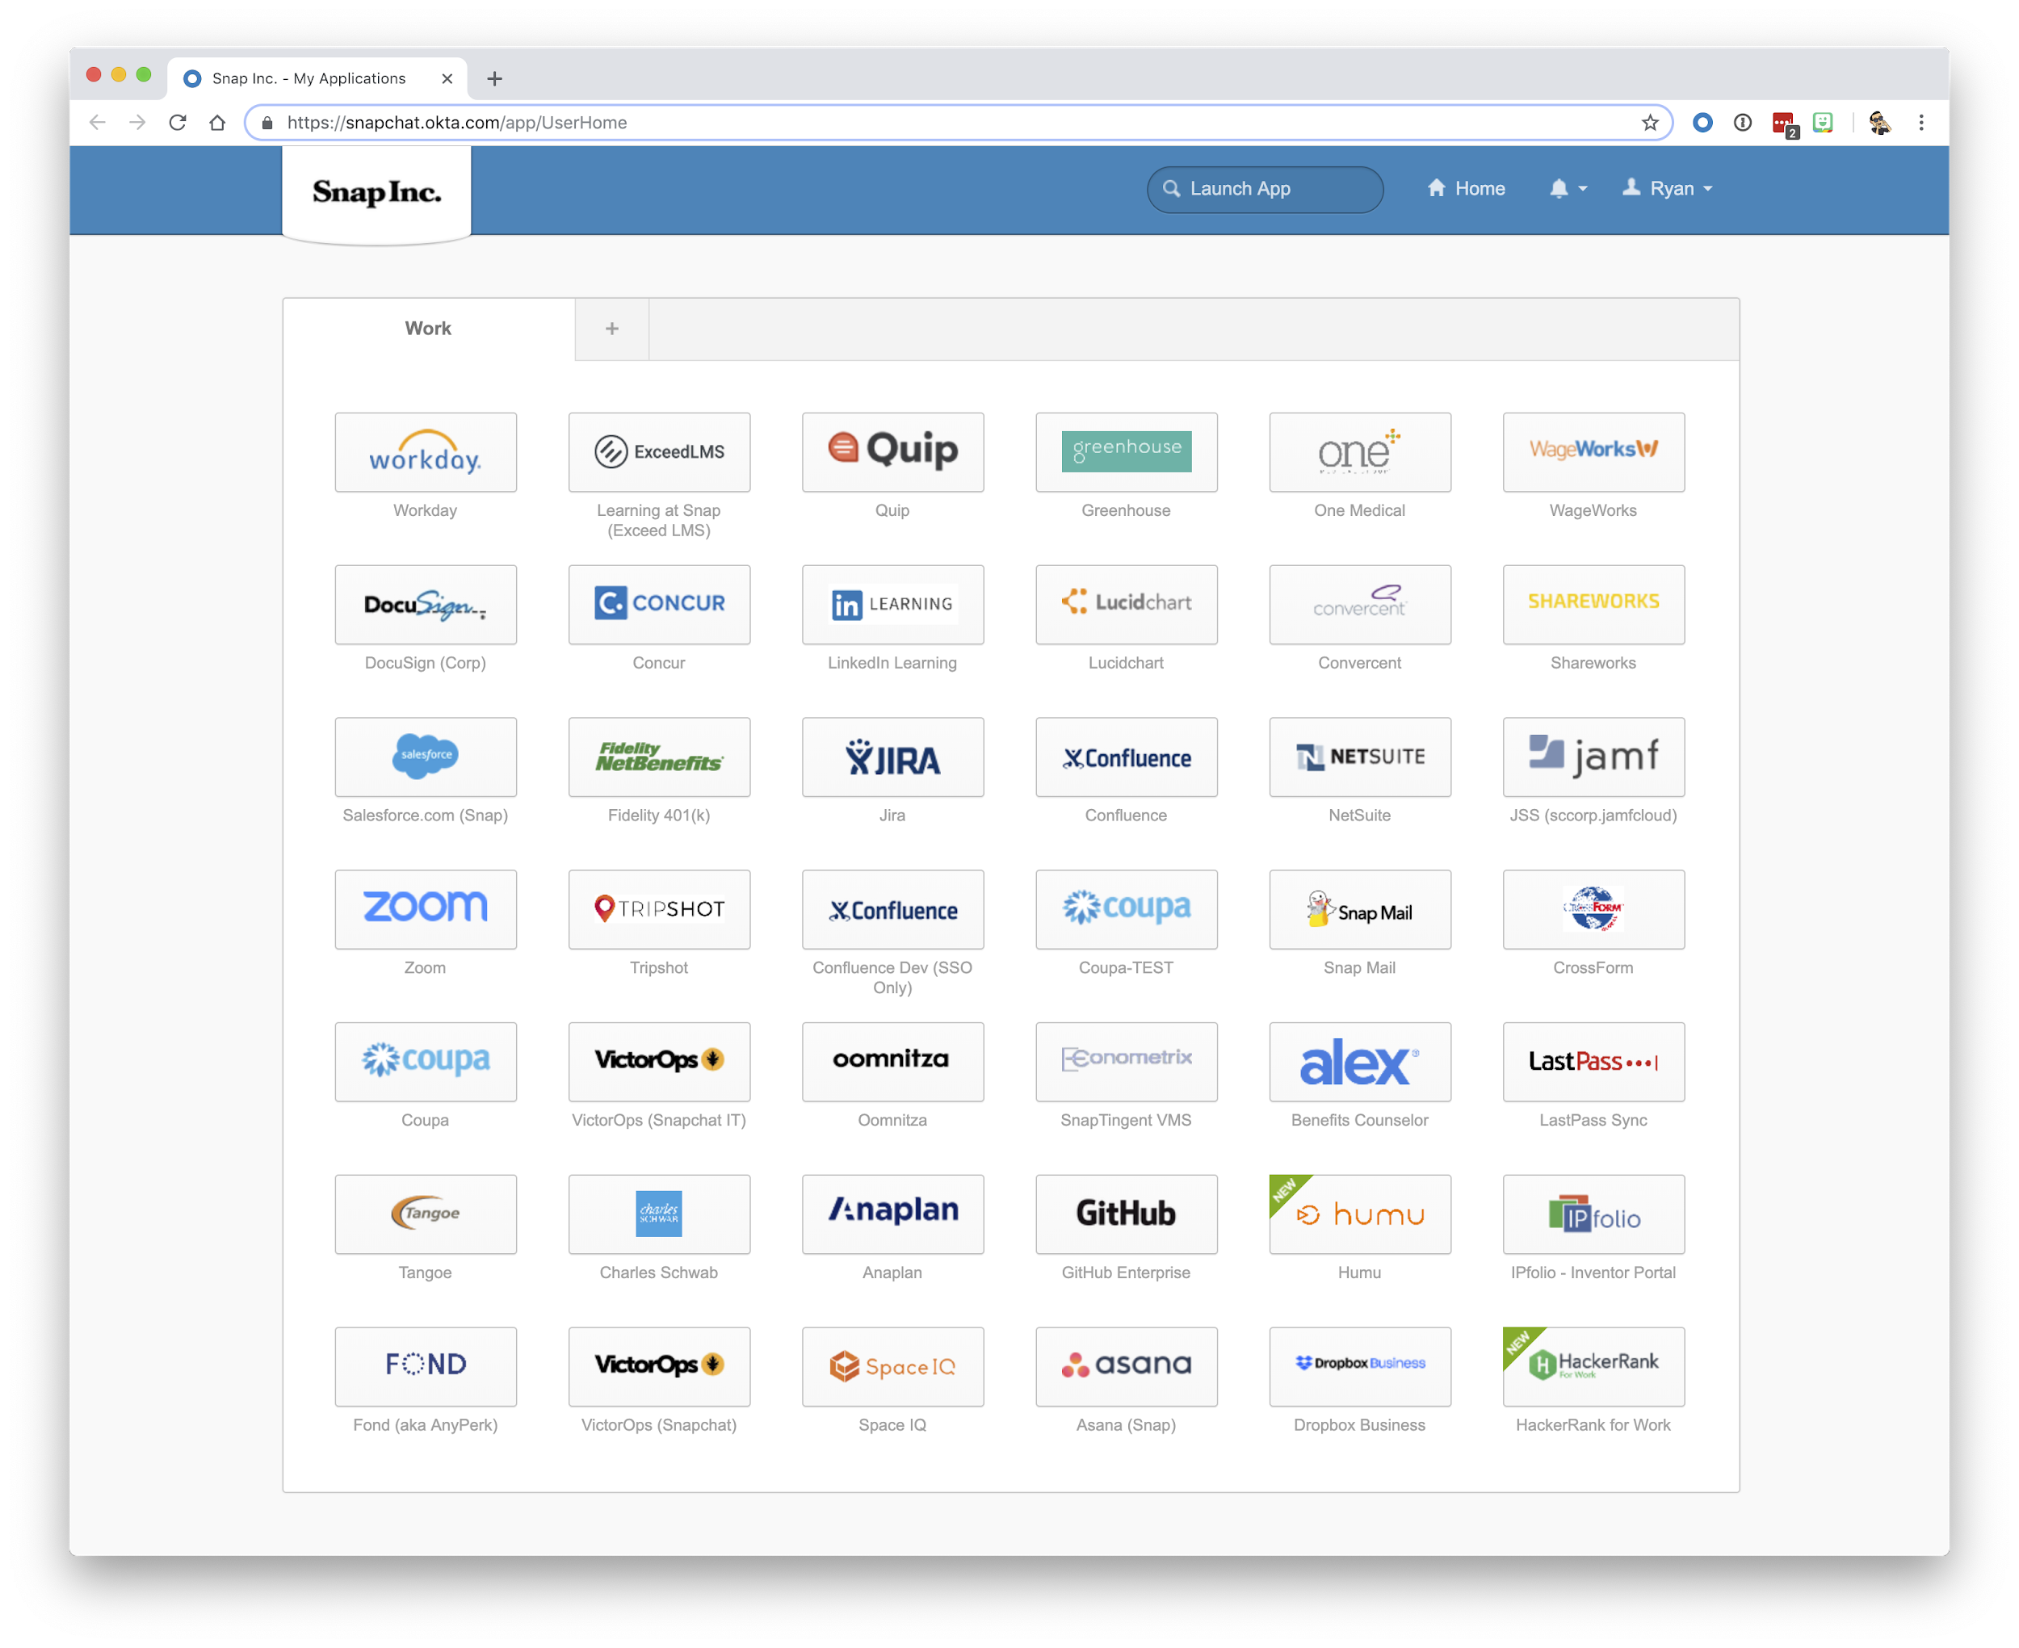
Okta
SSO
We use Okta as a single-sign on solution, allowing you to sign into one app or access to everything you need!

Slide 16
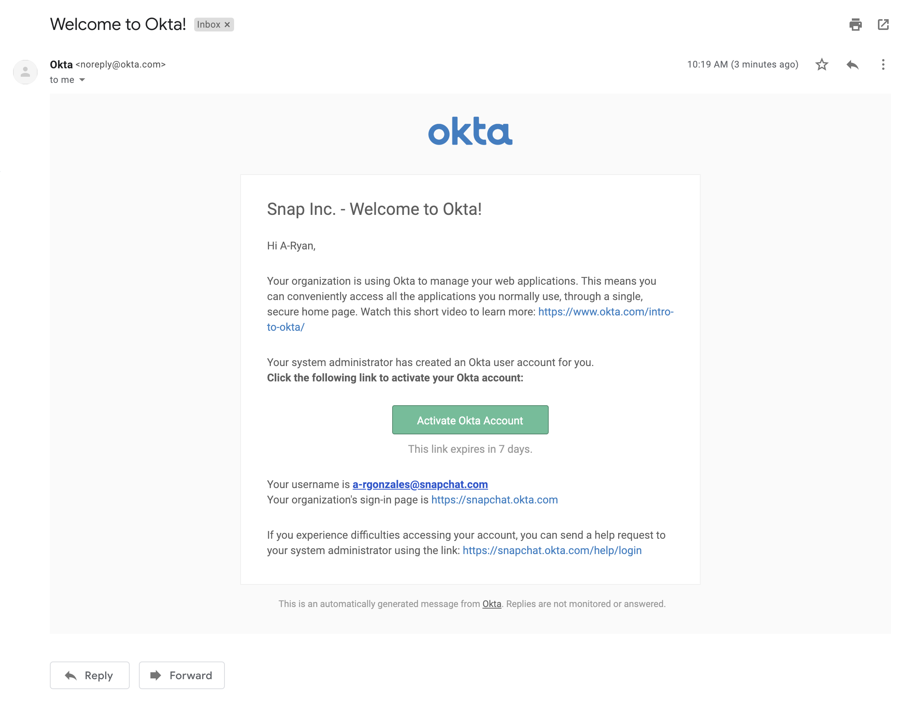
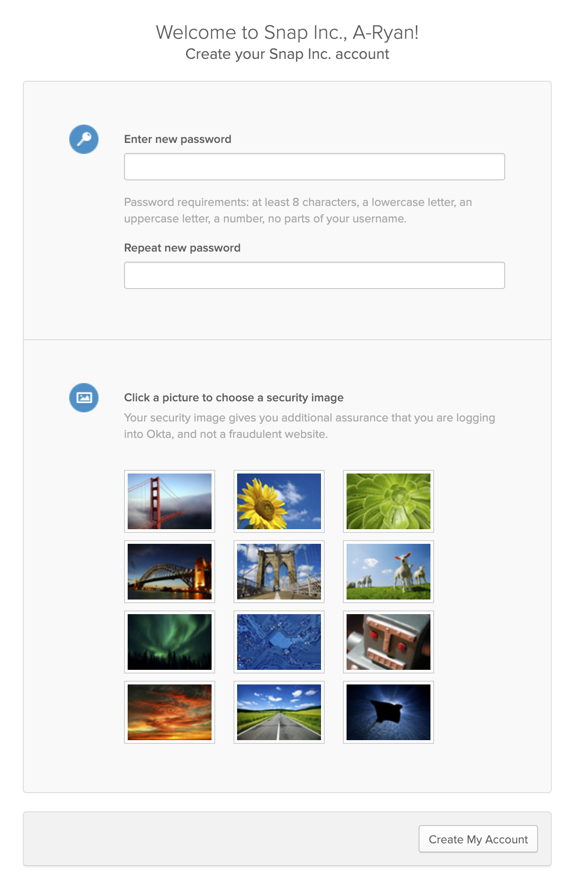
Activate Okta Account
You should have a “Welcome to Okta” email waiting for you in your inbox. Follow the link there to set up Okta! (if you do not have this email, please contact your manager)

Slide 17
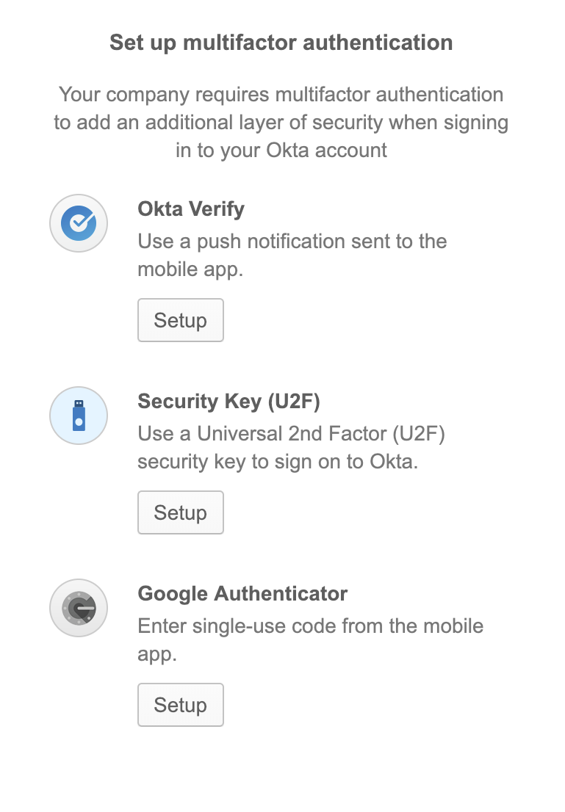

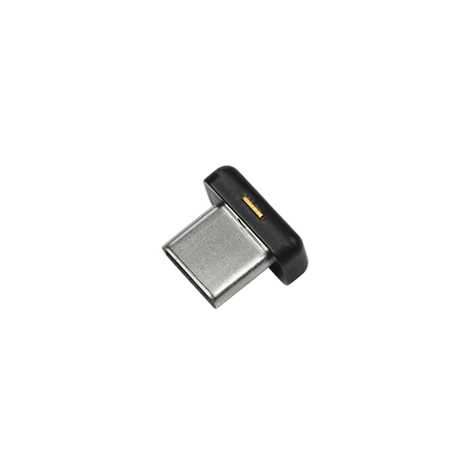
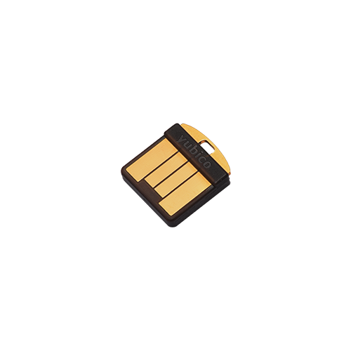

Okta 2-Step Verification
Make sure to set up two-step verification for your Okta account, just like we did with Google!
Insert Image here
Insert Image here
Insert Image here
Okta Verify
USB Security Key
(YubiKey)
Google Authenticator

Slide 18
Contacting Us
go/TechLounge
TechLounge Snappy Page
TechLounge@snap.com
Generates JIRA Support Ticket

